Slide 1
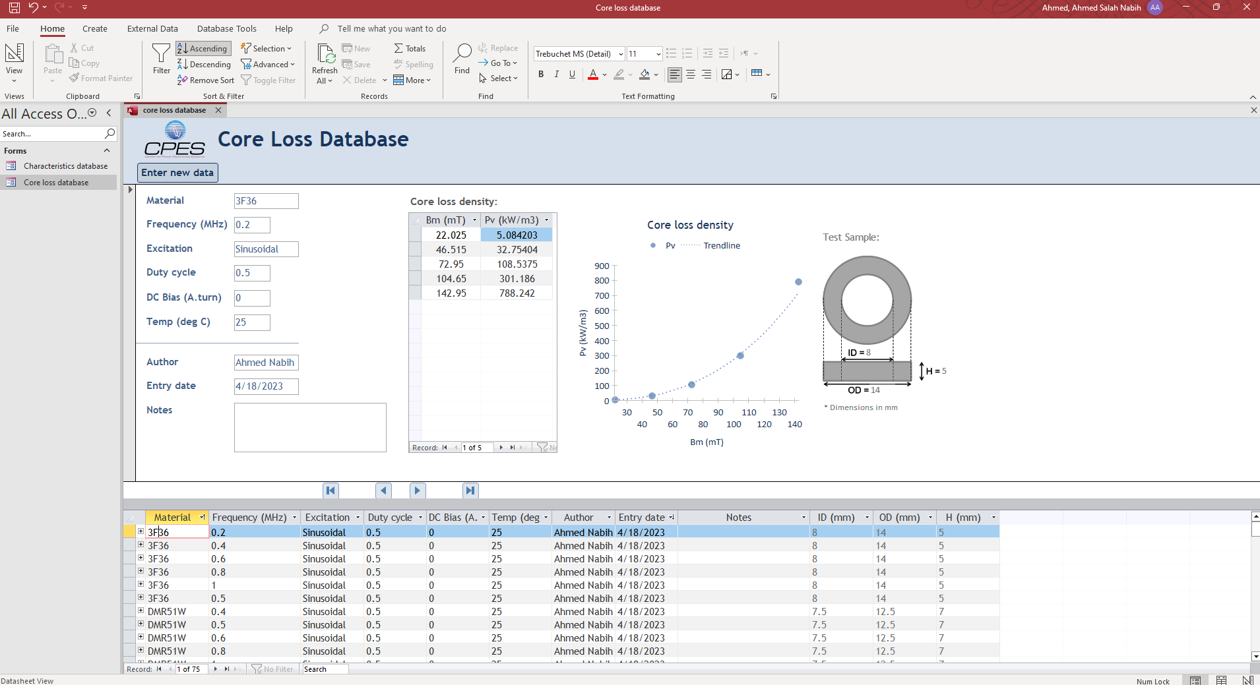
Core loss database
3) Enter the new data Button. Click it to go to data entry window
4) Core loss data in excel table format. You can copy directly to excel sheet.
1) Core loss database tab
5) Core loss data visualization and trendline
2) Database view window: shows the data for one measurement and the conditions of measurement (Material name, frequency, Excitation, duty cycle, DC bias Temperature, author, entry data)
6) Dimensions of test sample
3) Notes section to indicate any other special test conditions

Slide 2
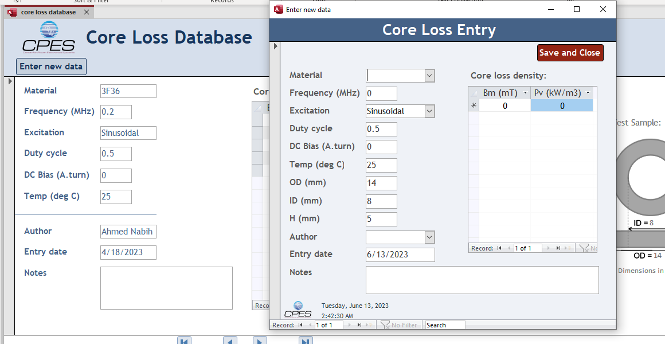
Entering new data
5) After adding all data, press “Save and close”. Make sure all data is correct before you hit save.
1) Click “Enter new data” to go to data entry window
2) data entry window
3) You have to enter all test data conditions. The notes section is optional
4) Enter the test data in the shown excel table. You can copy data from excel sheet and paste it here by pressing right click on the top left corner of the table and then press “paste”

Slide 3
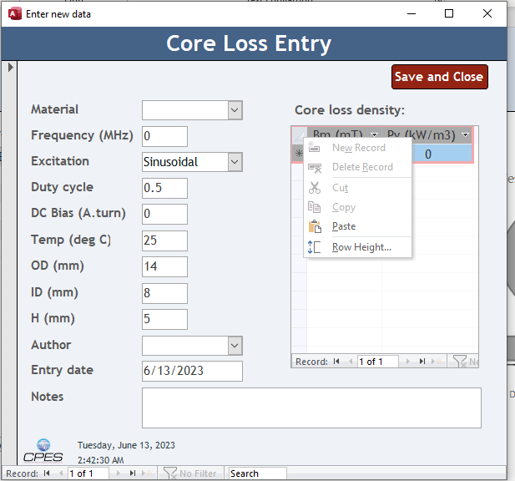
Entering new data (2)
4) Enter the test data in the shown excel table. You can copy data from excel sheet and paste it here by pressing right click on the top left corner of the table and then press “paste”

Slide 4
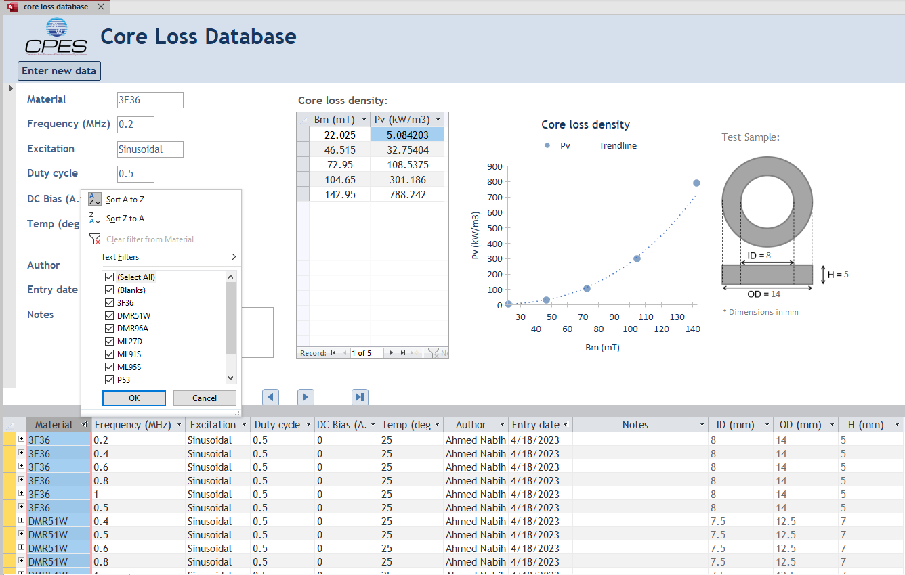
Filtering through database
1) The bottom table shows all the test points. You can filter through them using the filter function by clicking the down arrow on the right of each column header and selecting which description you are interested in.

Slide 5
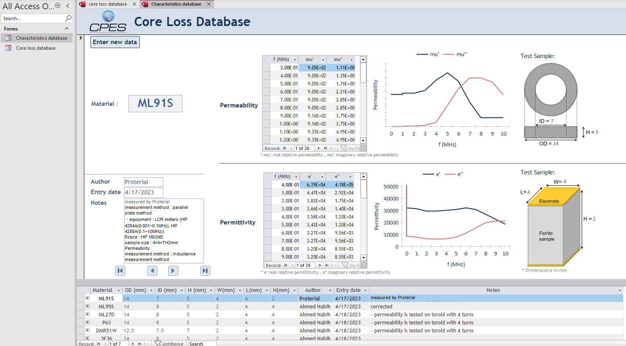
Characteristics database
Material characteristics database tab
Permeability data in excel table format. You can copy directly to excel sheet.
Enter the new data Button. Click it to go to data entry window
Core loss data visualization and trendline
Database view window: shows the data for one measurement and the conditions of measurement
Dimensions of test sample
Dimensions of test sample
Notes section to indicate any other special test conditions
Permittivity data in Excel table format.

Slide 6
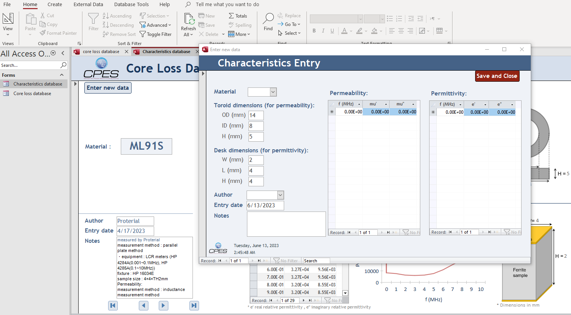
Entering new data
5) After adding all data, press “Save and close”. Make sure all data is correct before you hit save.
1) Click “Enter new data” to go to data entry window
2) data entry window
4) Enter the test data in the shown Excel table. You can copy data from Excel sheet and paste it here by pressing right-click on the top left corner of the table and then pressing “paste.”
3) You have to enter all test data conditions. Sample dimensions are important and impact the measurements. The notes section is optional

Slide 7
Test sample
W=
L=
Electrode
H =
Ferrite sample
ID =
H =
OD =

